Slide 1
Reproduce stock portfolio optimization -Python to R
Hanwen Miao

Slide 2
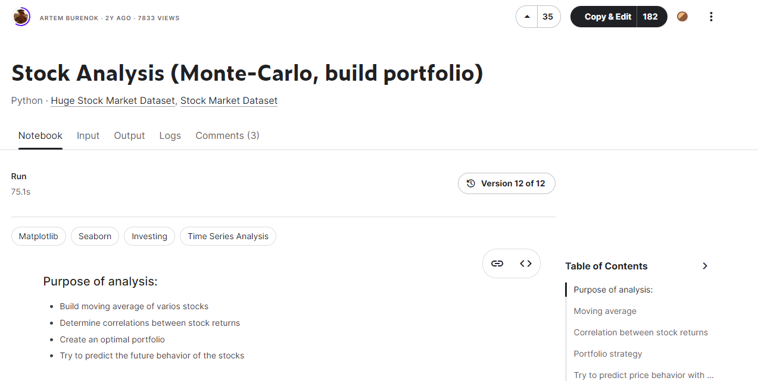
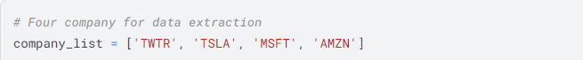
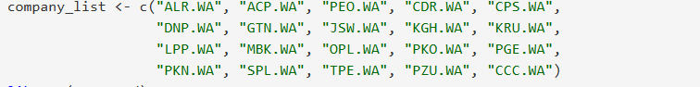

Slide 3
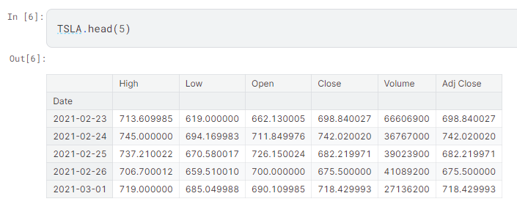
Two issues : No twitter on yahoo / Stock price difference

Slide 4
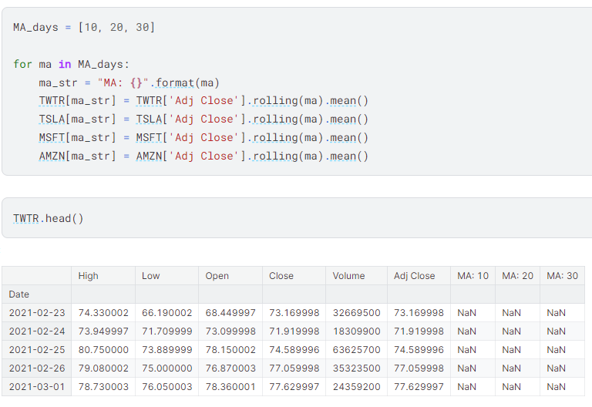
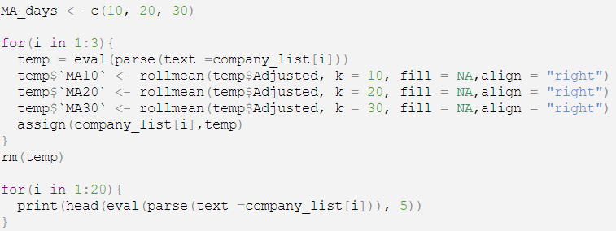
1 : Moving average

Slide 6
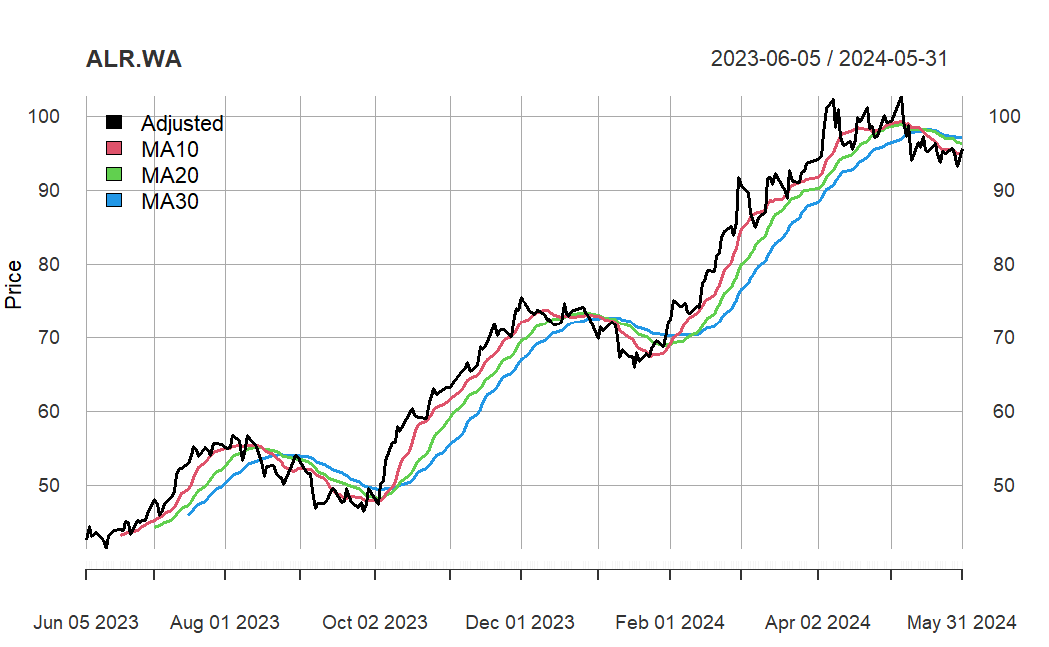
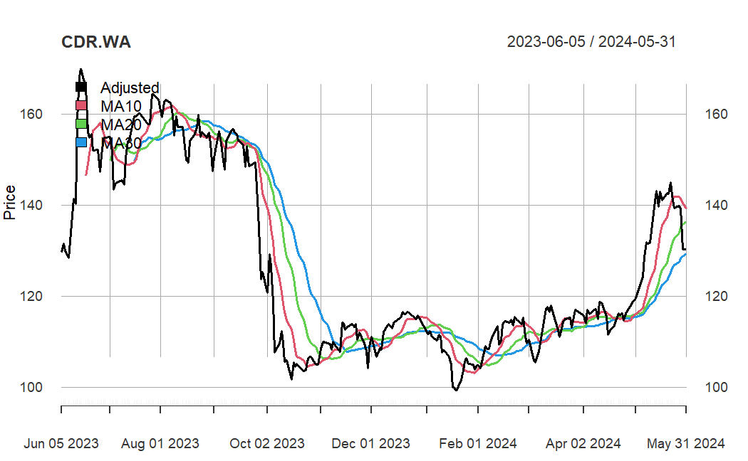
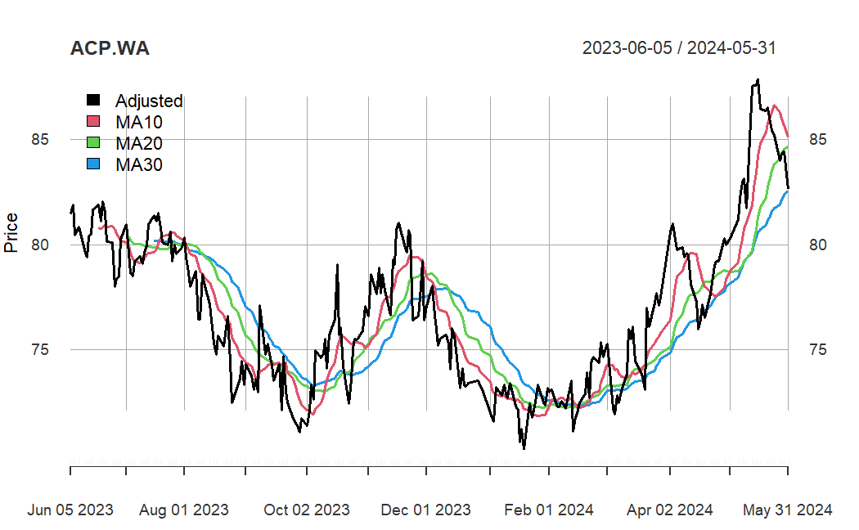
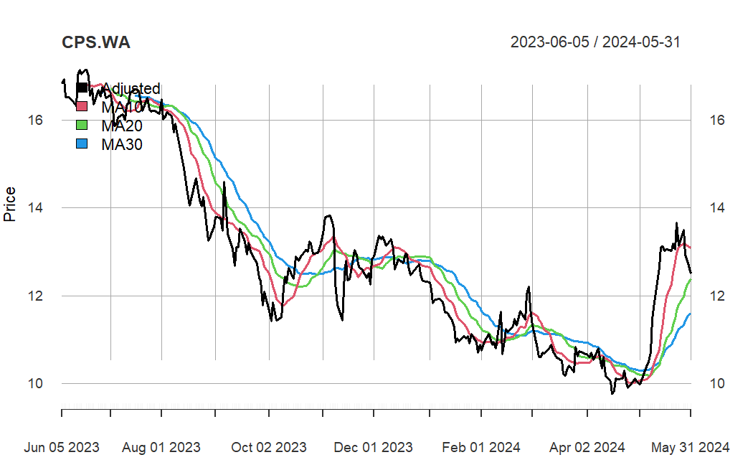

Slide 7
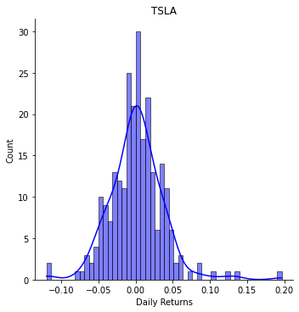
2 : Calculate returns and draw distribution

Slide 8
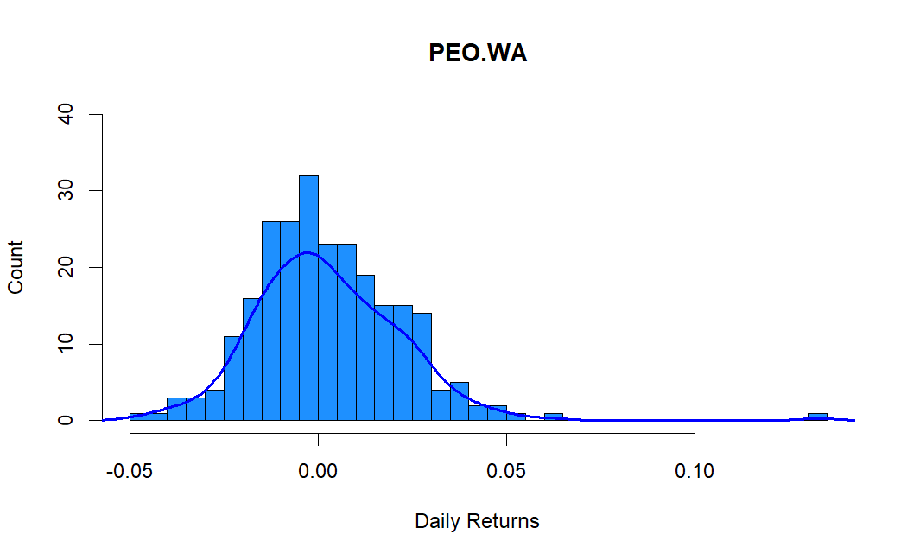
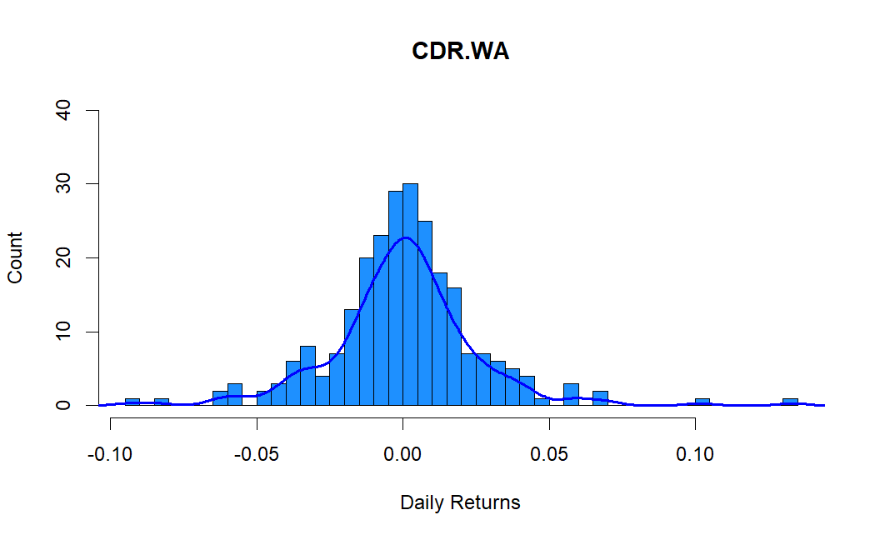

Slide 9
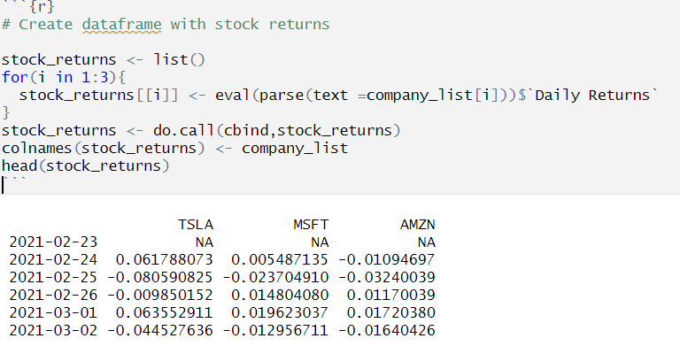
3. Correlation between stock returns

Slide 10
4 : The pairwise relationships between stock returns

Slide 11
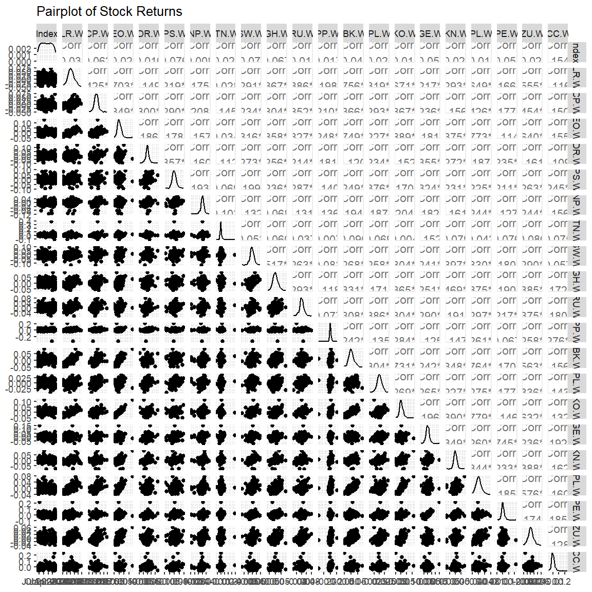

Slide 12
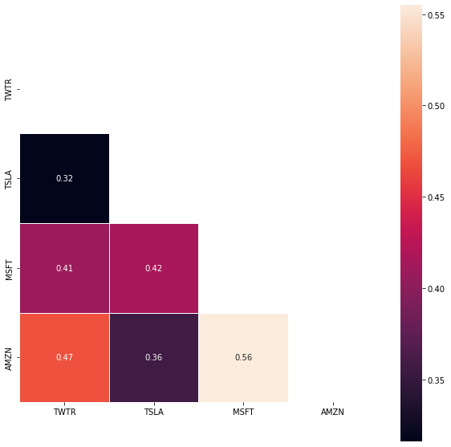
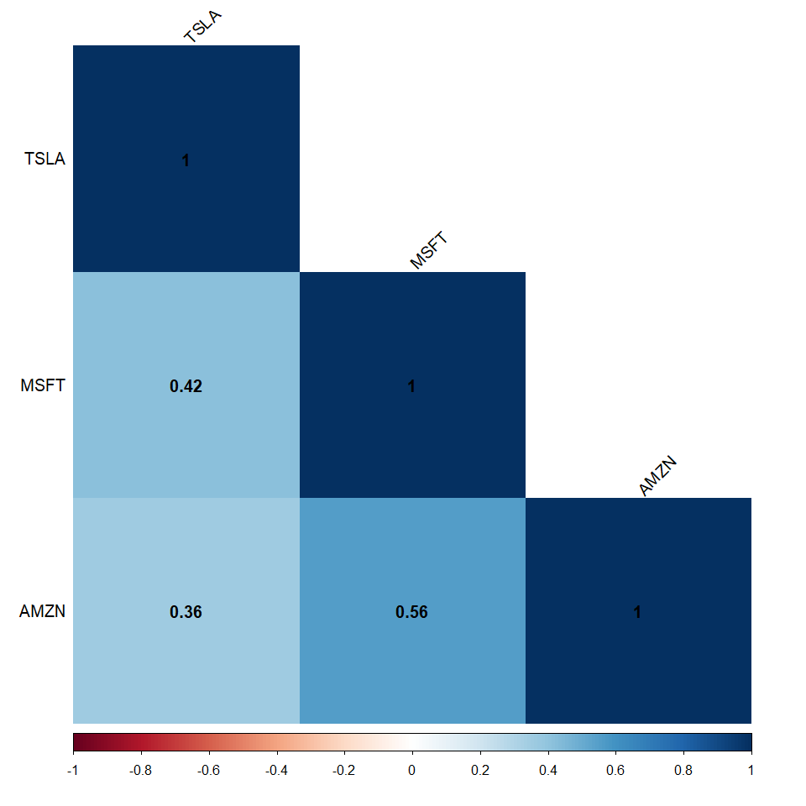
5. Build correlation matrix
The positive correlation between Microsoft and Amazon returns is the highest.

Slide 13
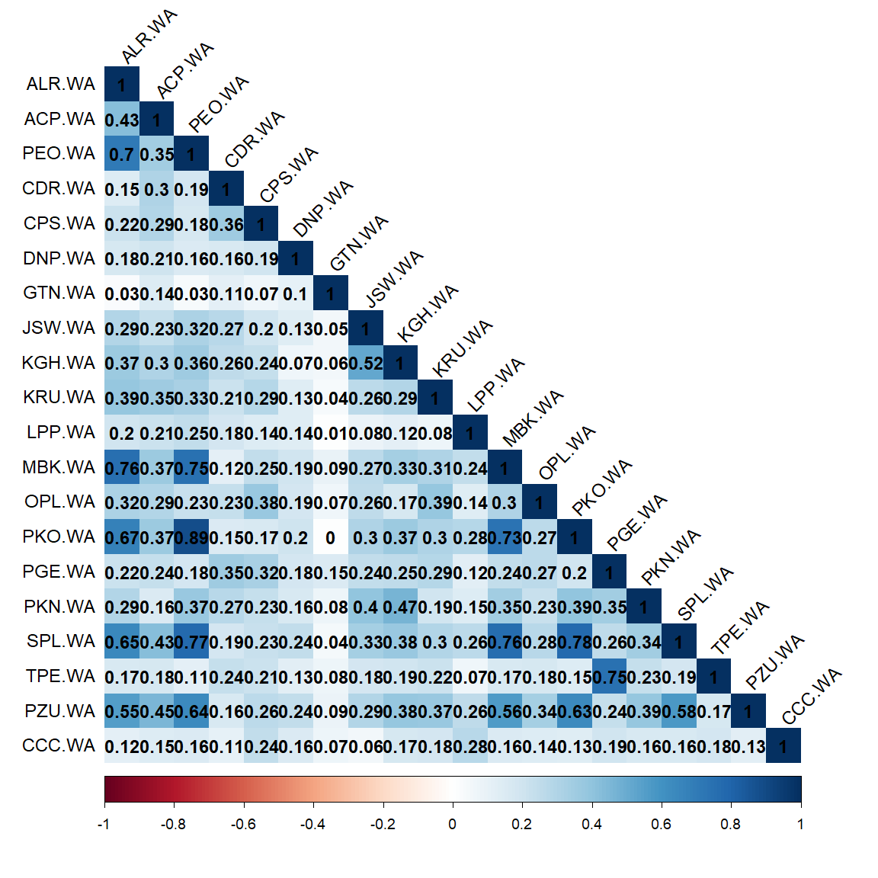

Slide 14
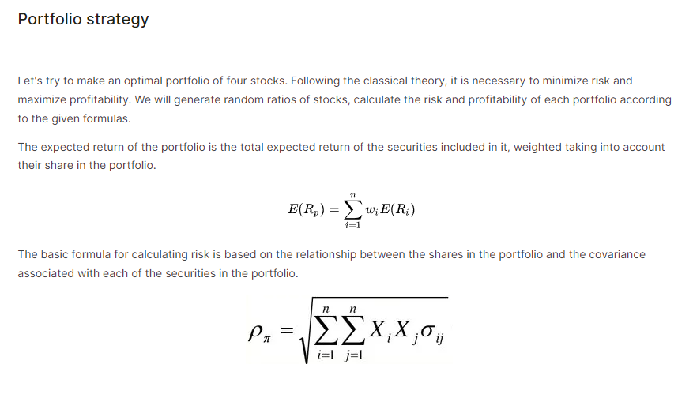

Slide 15
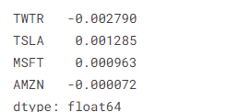
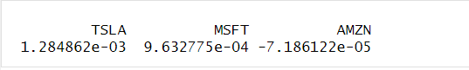
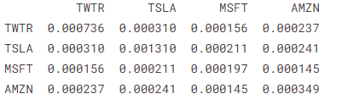
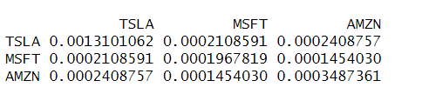
6. The mean income and the covariance of returns

Slide 16
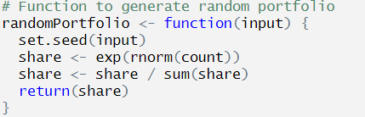
7 : Generate random portfolios, assigning weights, and finding the optimal one.
He generated an array that contains random numbers from a standard normal distribution. By taking the natural exponential of these random numbers, the weights are ensured to be positive. Each element of the array is then divided by the sum of all elements . This step ensures that the sum of all weights equals 1.
I made a function to accept a parameter for setting the random seed, to ensure that the generated random portfolio weights are reproducible.

Slide 17
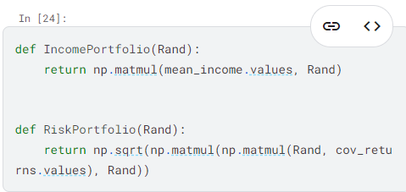
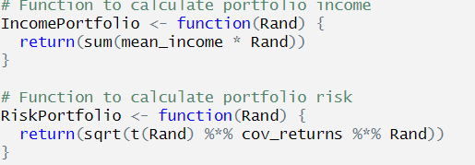
8 . Income and risk of portfolio
Income is calculated as the mean income of the stocks times the random weights. Risk is the standard deviation of the portfolio, calculated by first multiplying the transposed weight vector with the covariance matrix, and then multiplying the result by the weight vector.

Slide 18
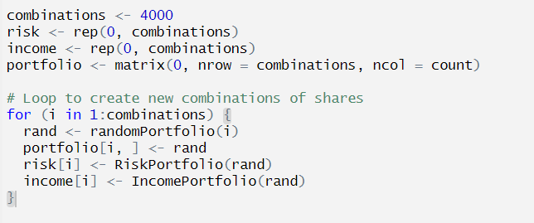
9 : Find the best portfolio - Maximum Sharpe ratio
I generated 4,000 random portfolios and calculated their income and risk. By calculating the Sharpe ratio, which is the ratio of return to risk, I identified the investment strategy with the maximum Sharpe ratio and visualized it using a plot.

Slide 19
10 . Max sharpe ratio portfolio

Slide 20
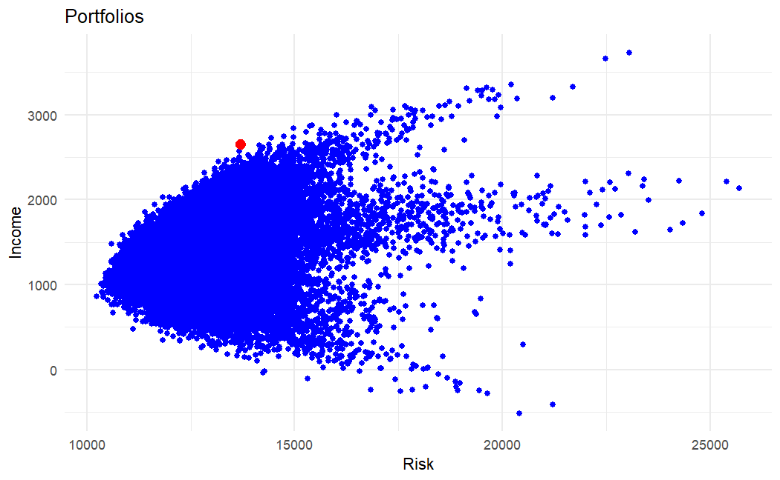
WIG20

Slide 21
P11 : Weights of each stock in best portfolio
It is evident that heavily investing in Microsoft from 2021 to 2022 would be a good choice. Although Tesla did not perform well in 2022, its stock rose by 90% in 2023.

Slide 22
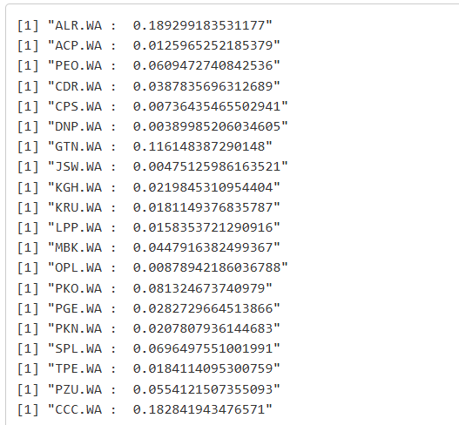
WIG 20 portfolio stocks’ weights

Slide 23
12. Predict the future price by Monyo Carlo simulation - 2023
Shock represents the random fluctuation part of the price. Drift is the expected change in price. The price for the current day is the previous day's price plus the previous day's price multiplied by the rate of change in price for the current day.

Slide 25
TESLA The predicted prices still fluctuate around the initial price (270). I compared it with the actual stock prices, and the predicted trend is slightly higher than the actual stock price trend.

Slide 26
Microsoft

Slide 27
Amazon

Slide 28
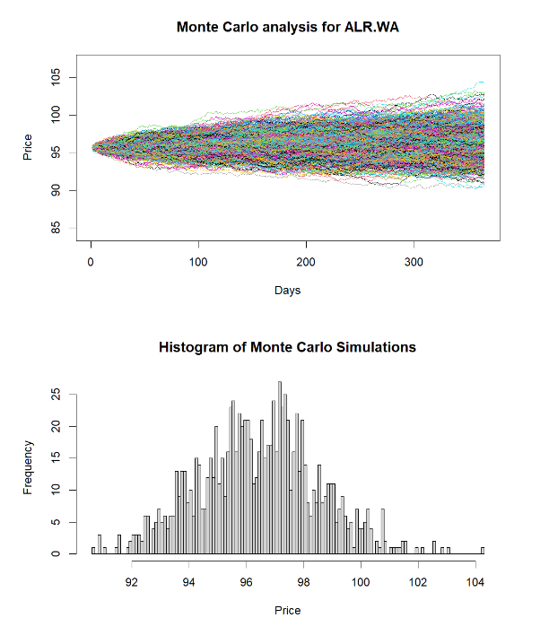
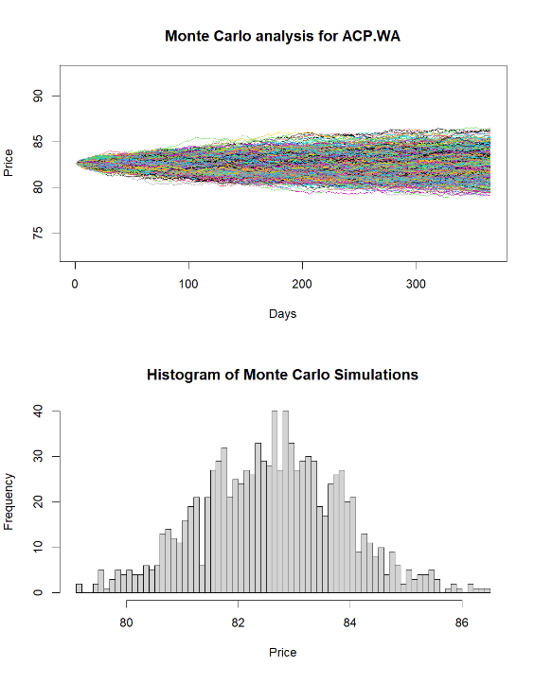

Slide 29
Thanks for watching
Hanwen Miao

